Slide 1
Adaptive Lossless Compression of Floating-Point Time-Series Data Using Enhanced XOR-Based Encoding
CSI3019 – ADVANCED DATA COMPRESSION TECHNIQUES
TEAM MEMBERS:
22MID0012 SUVATHI S
22MID0025 HARITHA R
22MID0308 SUJITHA T
22MID0319 SHRINIDHI K
22MID0339 RAKSHANA B

Slide 2
Abstract
Growth of time-series floating-point data in IoT, servers, finance, etc.
Challenge: Large storage, high transmission cost, and computation overhead.
Solution: ACTF (Adaptive Compression with Triple Features)
– a novel lossless compression algorithm.
Combines data preprocessing, new coding strategies, and feature refinement.
Achieves +12.25% compression ratio and +27.21% efficiency compared to Gorilla, Chimp, Chimp128.

Slide 3
Existing Methodology
Traditional Algorithms:
General compression (LZ4, Snappy, XZ, Brotli):
Fast but not specialized for time-series floating points.
Gorilla (Facebook): XOR-based, efficient but weak with trailing zeros.
Chimp / Chimp128:Improved Gorilla with better XOR and leading zeros handling.
Limitations:
Poor performance with long trailing zeros.
High redundancy in edge cases.
Limited adaptability to varied datasets.

Slide 4
Limitations of Existing Work
Trailing Zero Inefficiency
Both algorithms always output trailing zero fields (e.g., 6 bits in Gorilla), even when the trailing zero count is small or nearly zero—wastes bits.
Limited Handling of Leading Zeros
Fixed-length encoding for leading zeros (e.g., 5 bits in Gorilla) is not adaptive or efficient for datasets with frequent long zero runs.
Flag Structure Not Optimized
Shortest flag assigned to rare cases (exact value repeat), but most time-series values only partially repeat—opportunity for savings is missed.
Pattern Reuse is Limited
Only immediate previous value is used for compression; recurring XOR or center bit patterns beyond neighbor are ignored.
Struggles with High-Precision Data
On highly dynamic or high-precision data, savings are minimal due to lack of deeper pattern mining.

Slide 5
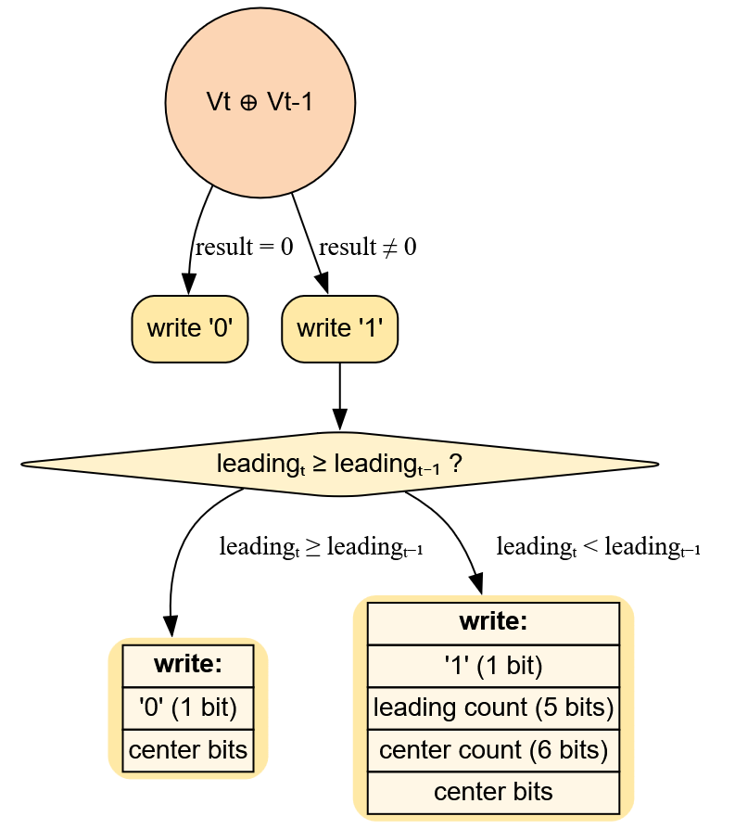
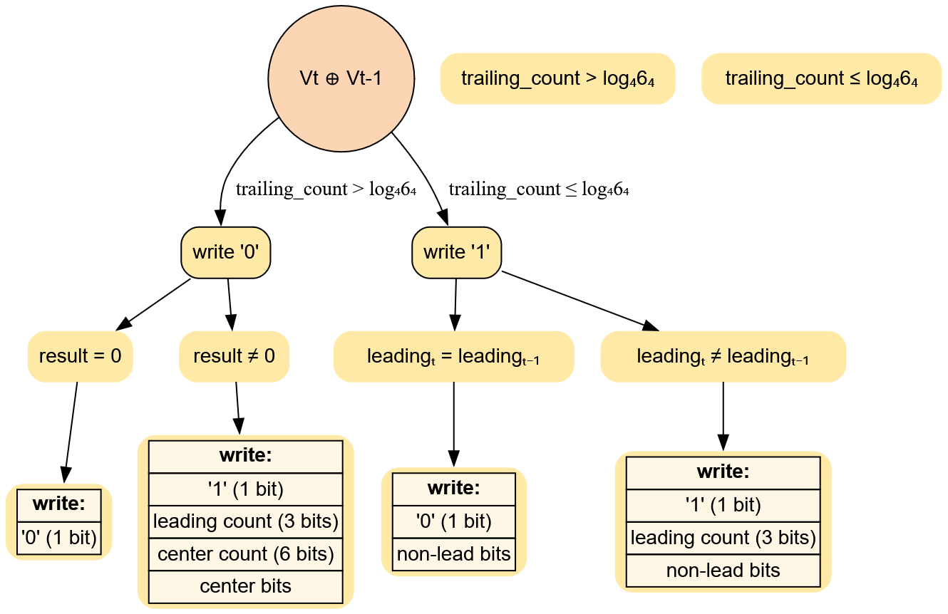
WORK FLOW OF EXISTING
GORILLA
CHIMP

Slide 6
Proposed Methodology (ACTF)
Step 1: Data Preprocessing
Pre-check for equality and encode repeats with a special flag ('00'), skipping unnecessary calculations.
Step 2: Coding Category Expansion
Introduces new branches ('110', '111') for recurring center/XOR patterns, further saving space on repeating structures.
Step 3: Feature Representation Refinement
Uses shorter fields and adaptive bit allocation for leading/trailing zeros, fitted to dataset statistics (e.g., restrict L_count, T_count for relevant cases).
Step 4: Robust Edge-Case Handling
Optimizes long plateaus, recurring centers, and runs of zeros using custom flags and encoding, not present in Gorilla/Chimp.
Step 5: Achieved Improvements
Higher compression ratios and faster (de)compression, especially for sensor, IoT, and scientific time series.

Slide 7
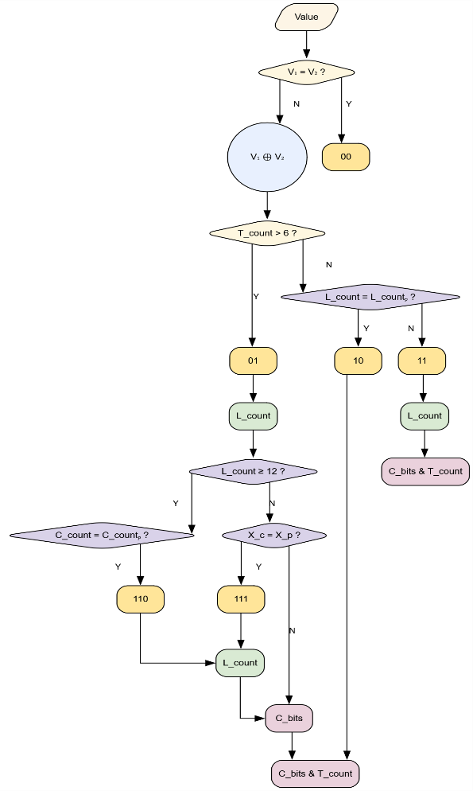
COMPRESSION WORKFLOW OF ACTF

Slide 8
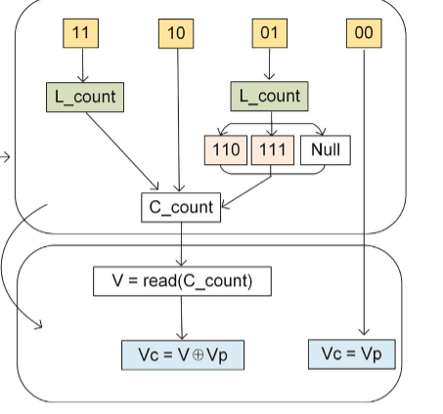
DECOMPRESSION OF ACTF

Slide 9
CONCLUSION
The ACTF algorithm provides significantly better compression ratios and speed compared to existing techniques like Chimp and Gorilla for floating-point time series, as demonstrated in experimental studies.
Existing algorithms are fast but leave space savings on the table due to limited flag structures and underutilization of recurring patterns and zero runs.
ACTF introduces smarter preprocessing and new encoding branches, which efficiently handle repeated values and adaptive bit allocation.
As a result, ACTF offers lossless compression, faster (de)compression time, and greater space efficiency in real-world scenarios.
By directly addressing the limitations of Chimp and Gorilla, ACTF is shown to be a superior method for time series floating-point data compression.

